Slide 1
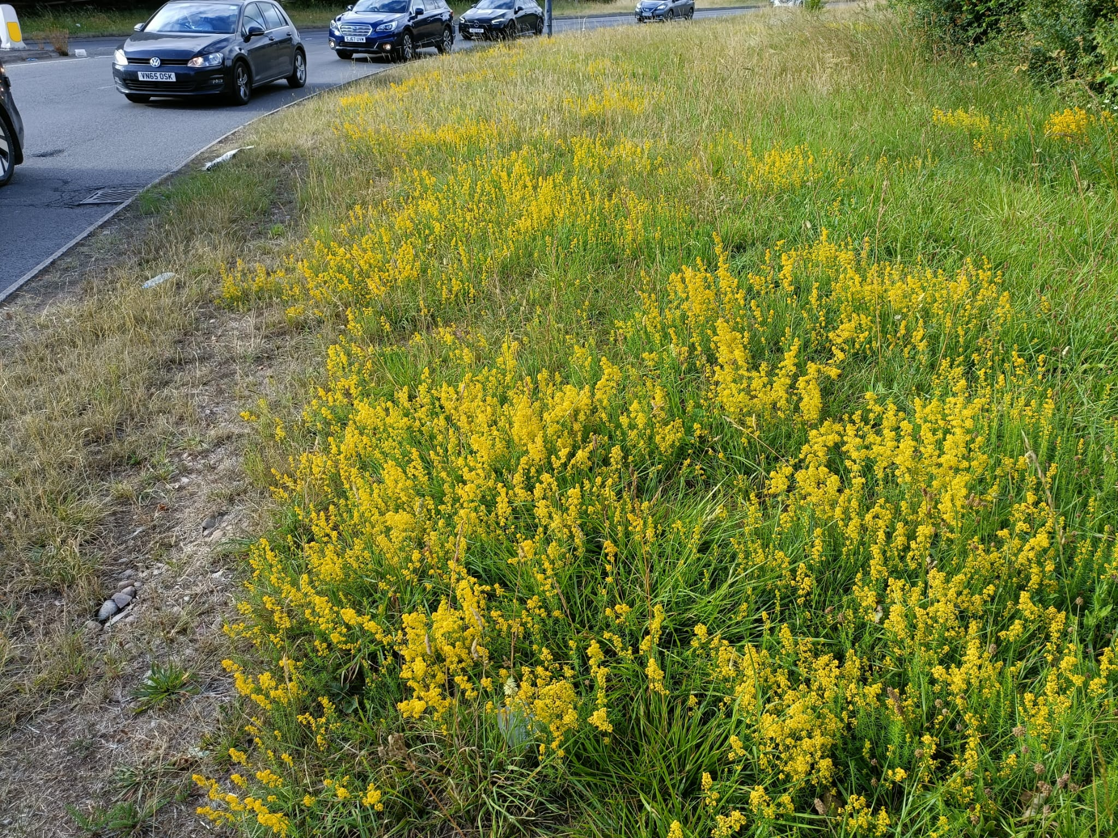
Verges
Why we should manage grassland verges for wildlife.
&
How to manage your verges for greater biodiversity.

Slide 2
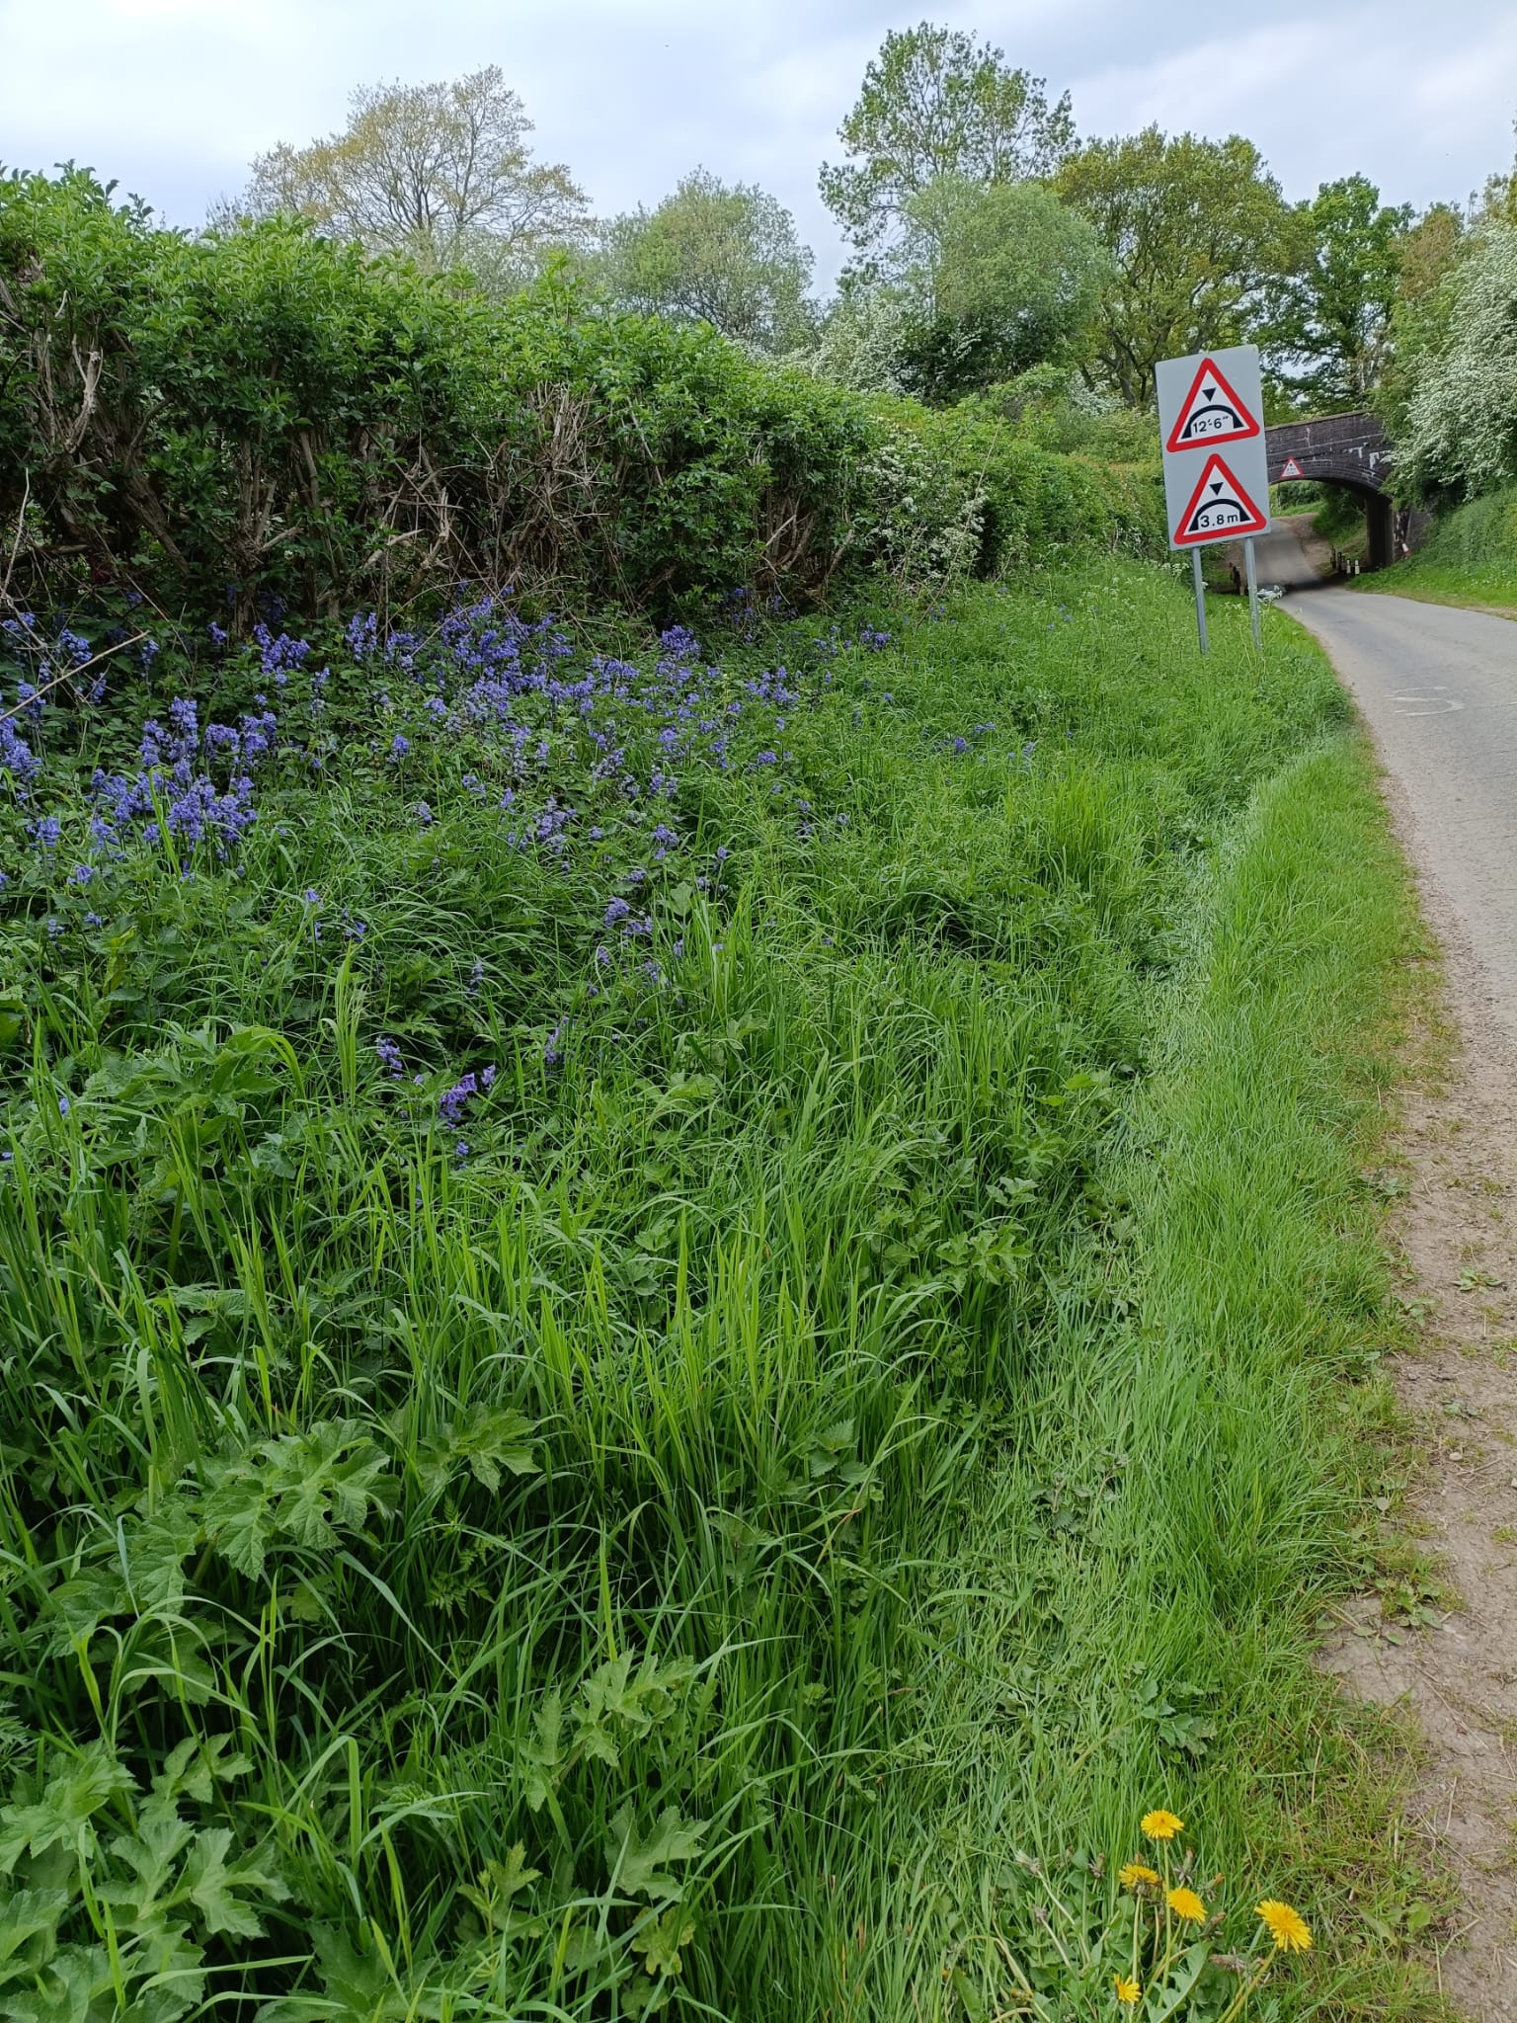
Why should we manage verges with wildlife in mind?
There are 400,000km of public road verges across Great Britain.
Verges provide essential wildlife corridors.
Longer grass results in more carbon sequestered both above & below ground.
Increased biodiversity increases resilience to climate change.
Notes:
Grass mown in June allows one generation of moths and butterflies to live. Grass mown at the end of Aug allows two generations of moths and butterflies to live. This is why we associate meadows with butterflies.

Slide 3
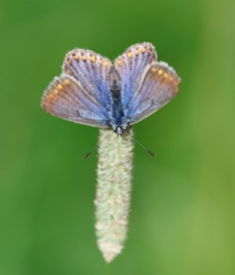
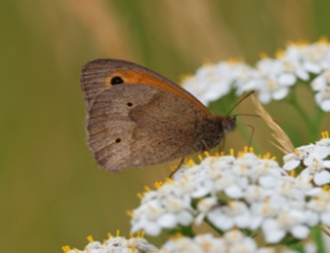
Why should we manage verges with wildlife in mind?
Many moths & butterflies lay eggs at the base of long grass.
Bees enjoy the long grass & the nectar from wildflowers allowed to flourish with them.
The creatures which live on grasses & wildflowers are food for other wildlife, such as hedgehogs & birds.
Increased biodiversity increases resilience to climate change.
Notes:
Grass mown in June allows one generation of moths and butterflies to live. Grass mown at the end of Aug allows two generations of moths and butterflies to live. This is why we associate meadows with butterflies.

Slide 4
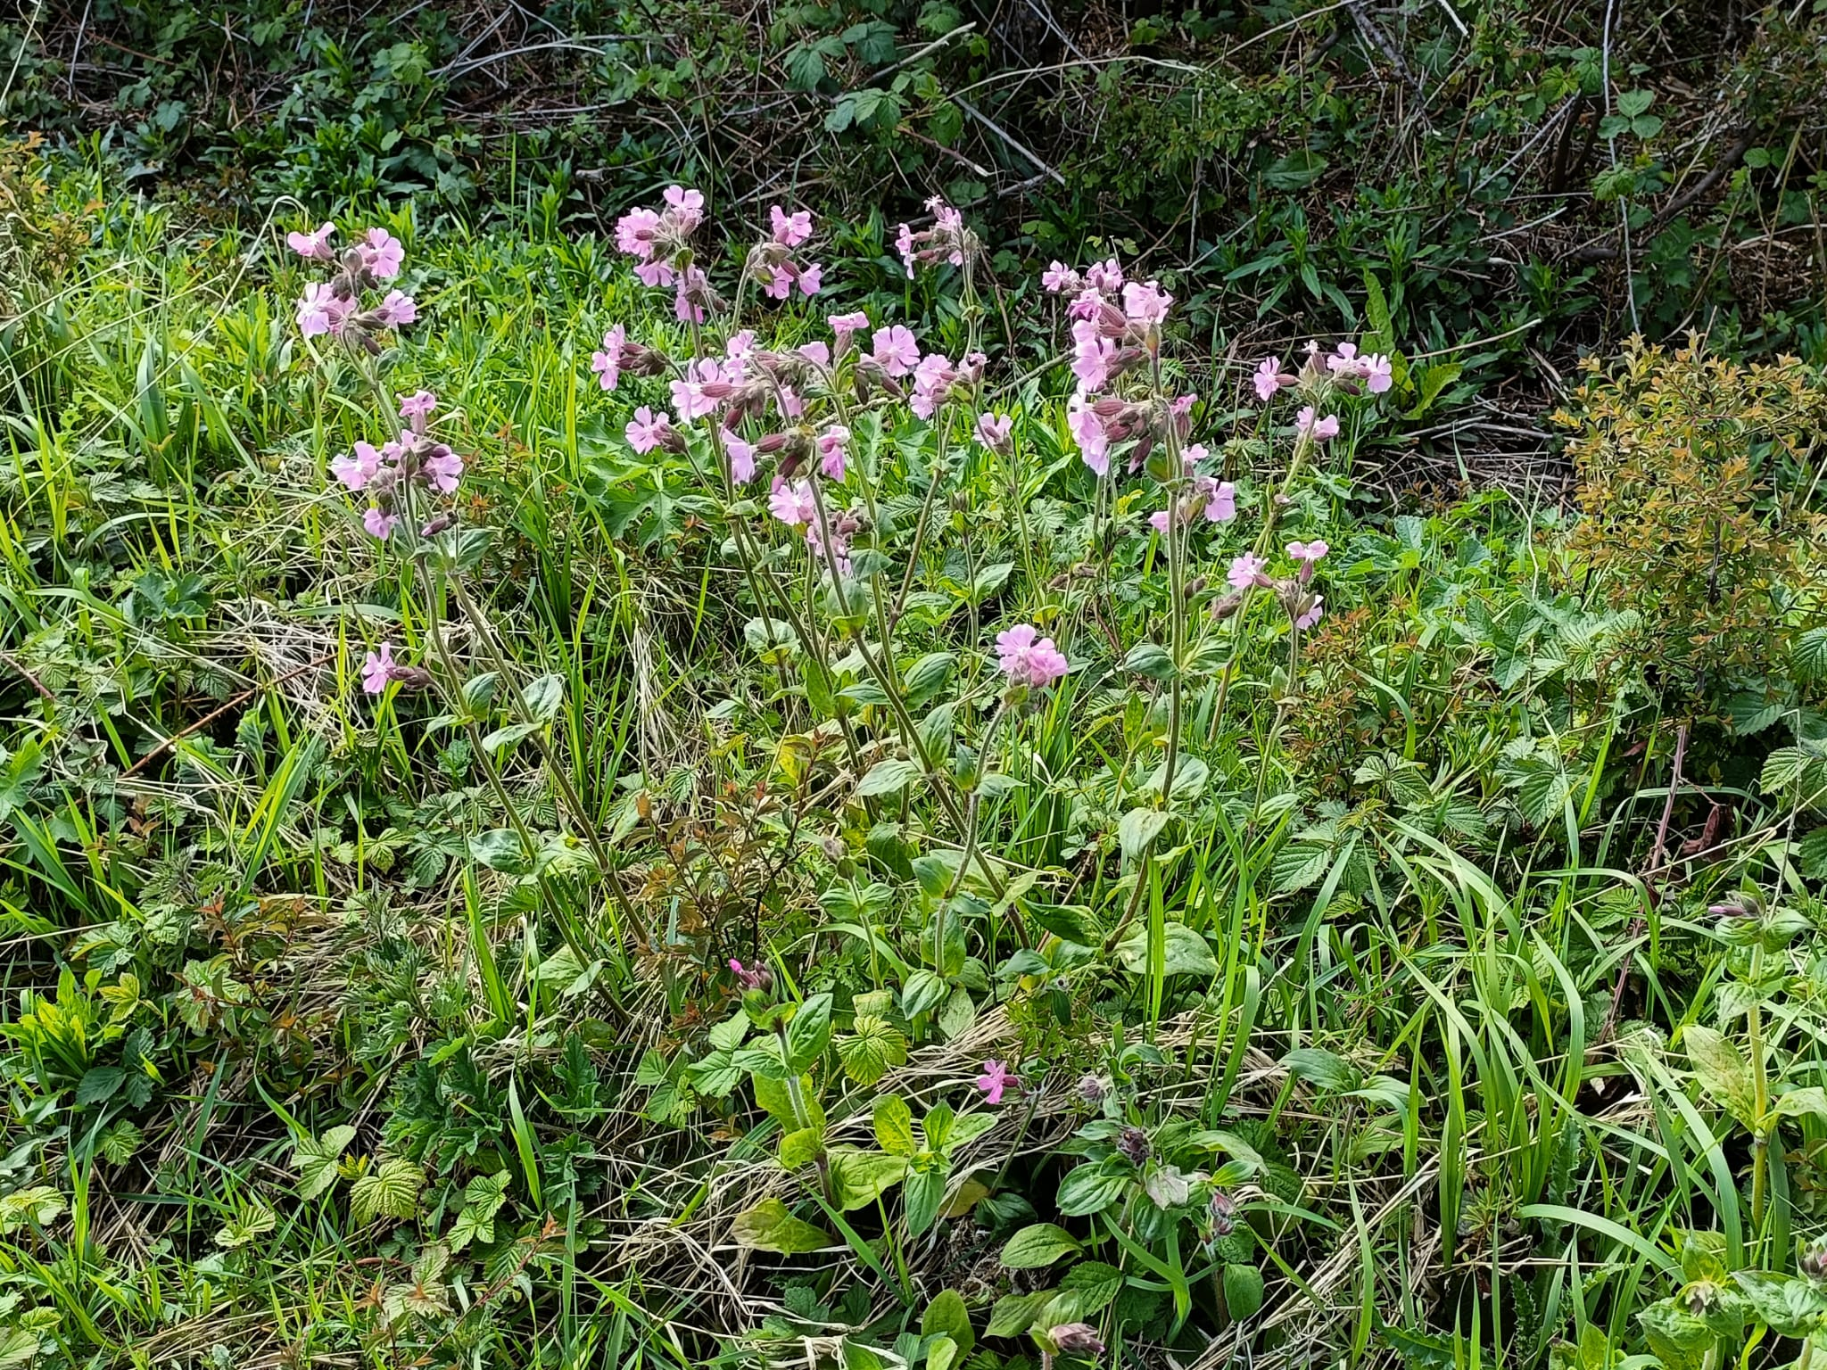
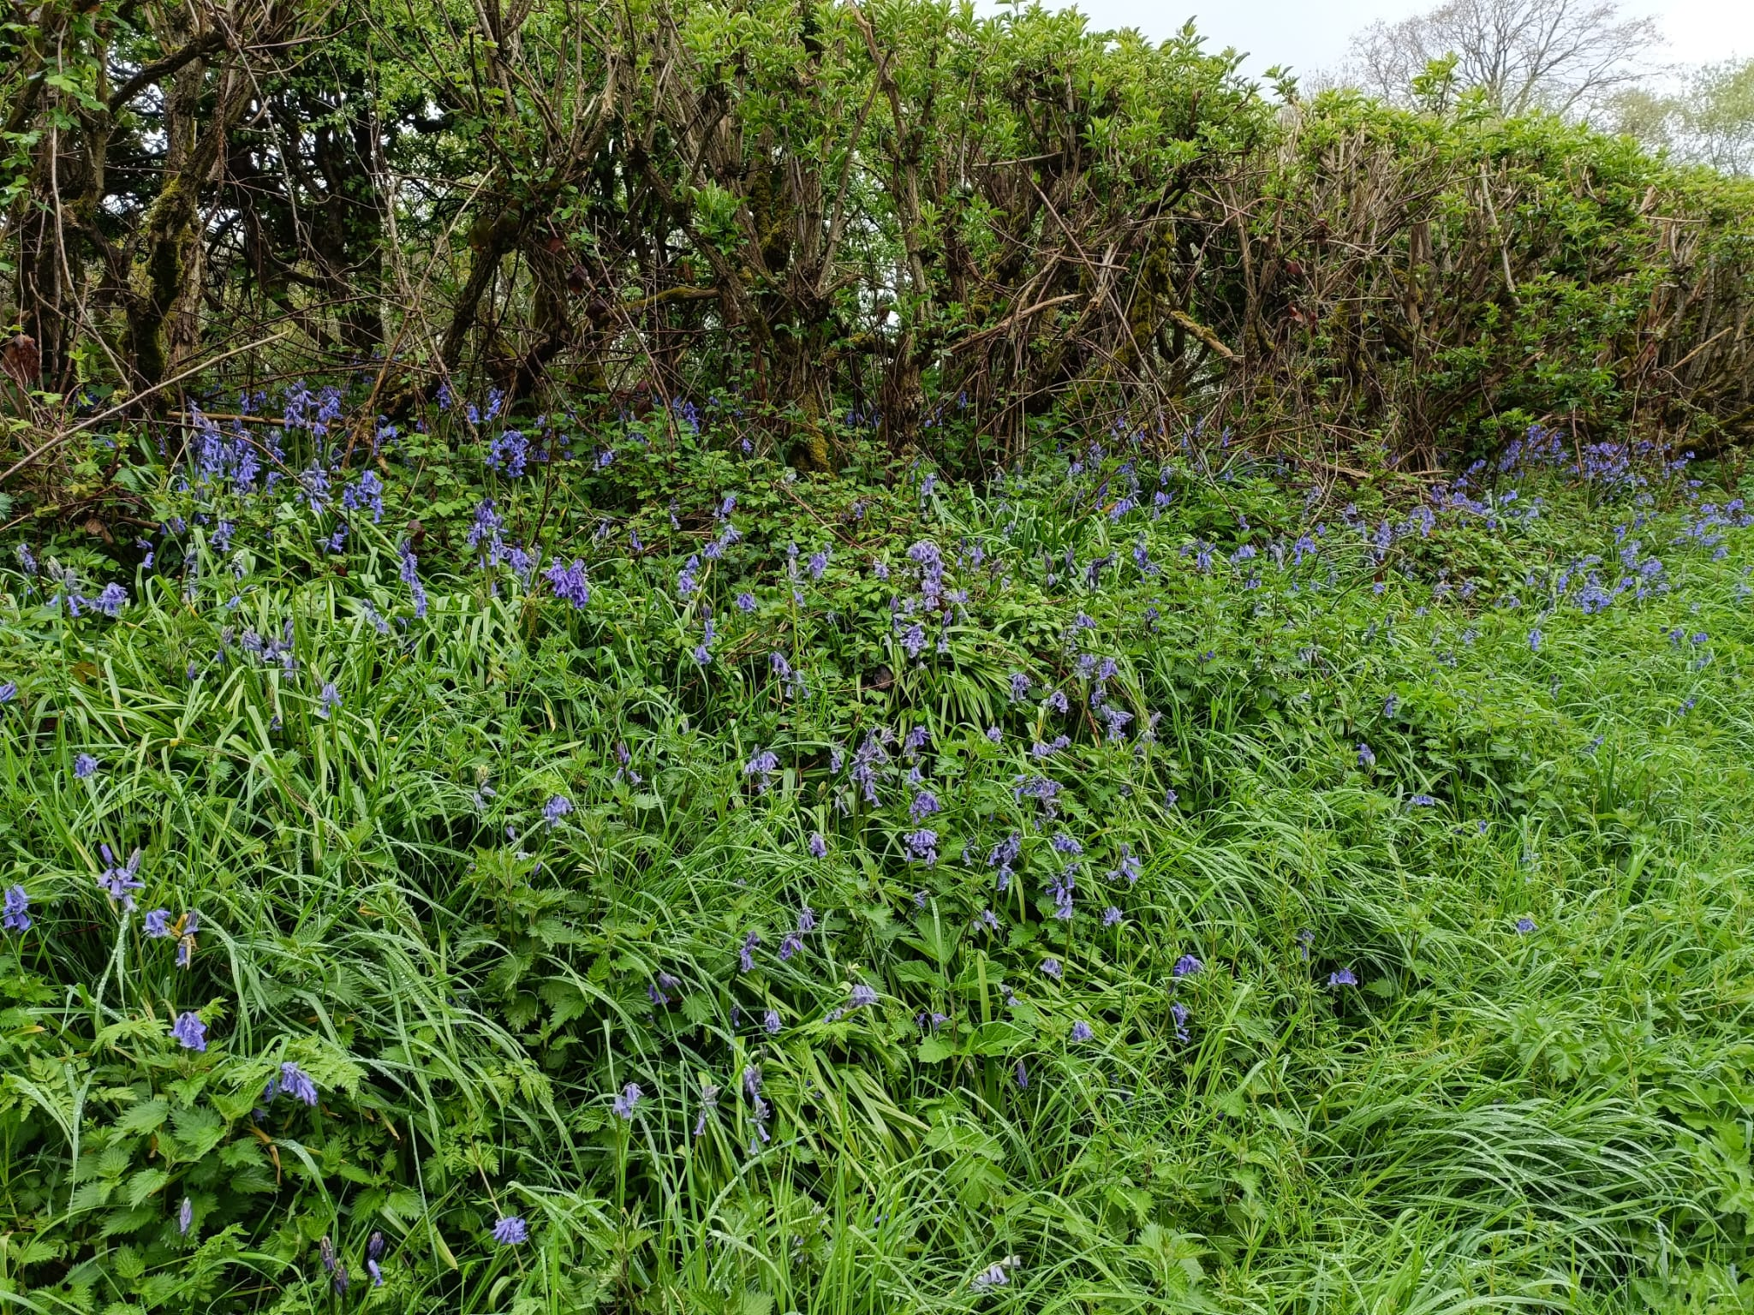



Why should we manage verges with wildlife in mind?
Reducing labour & fuel burned during mowing = lower management costs & lower carbon footprint.
Longer grass is more resilient in drought & flood, & the longer roots push more carbon into the ground.
Different mowing regimes create different wildlife habitats, which lead to increased biodiversity.
The biodiversity in the areas allowed to grow long will increase year on year.
Examples of counties where it works:
Notes:
Examples of Counties where it works
Here are some examples of councils who’ve made it work.
Dorset County Council has worked in partnership with Butterfly Conservation to enable wildlife to flourish along the A354 Weymouth relief road. Recently, thousands of pyramidal orchids could be seen blooming alongside other wildflowers.
Rotherham Metropolitan Borough Council has established eight miles of meadows alongside a motorway, saving £23,000 per year on mowing costs.
Denbighshire County Council currently has 11 roadside nature reserves scattered across the county which contribute to 10.7 acres of wildflower meadow.
Using a petrol or diesel mower can put up to 50% more carbon into the air than the mown grass is able to sequester.

Slide 5
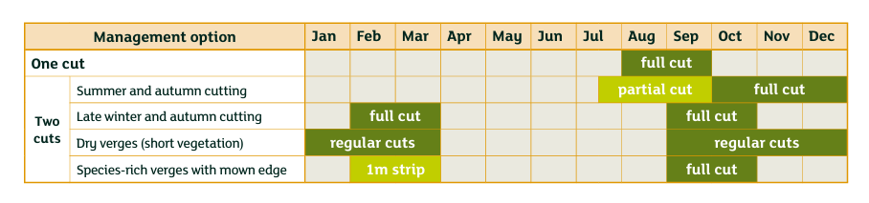
How to manage your verges for greater biodiversity.
Consider all stakeholders:
  Who owns & maintains the verges?
  Who will be impacted, e.g. householders?
  Contractors who mow the verges & clear
  the cuttings.
Adjust the mowing schedule for the year. Two options are shown below…..
  for biodiversity, a period of 6-8 weeks without mowing
  during May and June is a minimum requirement.
(Slide from Mark Schofield, Plantlife, 2023)
Notes:
Impact of different mowing regimes on wildlife
Cutting verges too early, too often or not at all reduces the number of wildflower species that grow. Wildflowers take approximately 6-8 weeks to flower and set seed but as each species works to a different timescale, it’s important not to cut during the flowering season so as to support the varied lifecycles of wildflowers.
Regular management of verges is, however, essential. Without it ‘tussock forming grasses can quickly dominate, reducing species diversity’. (PlantLIfe 2019)
Current practice
Verge mowing contracts typically state c18 mowings per year. This is spread across the year and typically means fortnightly mowing across the growing season. This leaves no chance for plants to flower (other than a few very low growing species) so they don’t set seed or produce nectar for insects. Mowings are not removed, increasing soil fertility favouring a few dominant species - hence biodiversity of these verges is poor.
Recommended practice
There is an ideal scenario set out in detail by the experts at Plantlife (www.plantlife.org.uk/our-work/road-verges/). Plantlife is leading the charge to bring about a systemic change in the way Britain’s verges are managed, bringing benefits for nature and climate. This approach typically involves mowing only once or twice per year.
Plantlife also recognises different mowing regimes for different wildlife and situations.

Slide 6
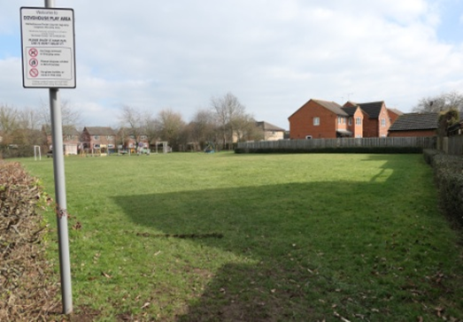
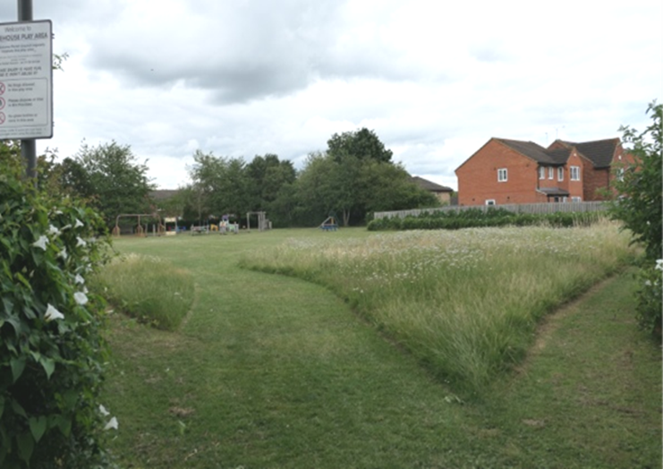
How to manage your verges for greater biodiversity.
Consider adopting the new mowing regime on a small part of the verges/green spaces, not the whole estate, example shown below
BEFORE AFTER
Notes:
Impact of different mowing regimes on wildlife
Cutting verges too early, too often or not at all reduces the number of wildflower species that grow. Wildflowers take approximately 6-8 weeks to flower and set seed but as each species works to a different timescale, it’s important not to cut during the flowering season so as to support the varied lifecycles of wildflowers.
Regular management of verges is, however, essential. Without it ‘tussock forming grasses can quickly dominate, reducing species diversity’. (PlantLIfe 2019)
Current practice
Verge mowing contracts typically state c18 mowings per year. This is spread across the year and typically means fortnightly mowing across the growing season. This leaves no chance for plants to flower (other than a few very low growing species) so they don’t set seed or produce nectar for insects. Mowings are not removed, increasing soil fertility favouring a few dominant species - hence biodiversity of these verges is poor.
Recommended practice
There is an ideal scenario set out in detail by the experts at Plantlife (www.plantlife.org.uk/our-work/road-verges/). Plantlife is leading the charge to bring about a systemic change in the way Britain’s verges are managed, bringing benefits for nature and climate. This approach typically involves mowing only once or twice per year.
Plantlife also recognises different mowing regimes for different wildlife and situations.

Slide 7
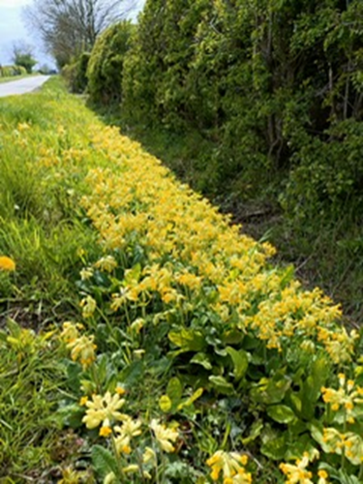
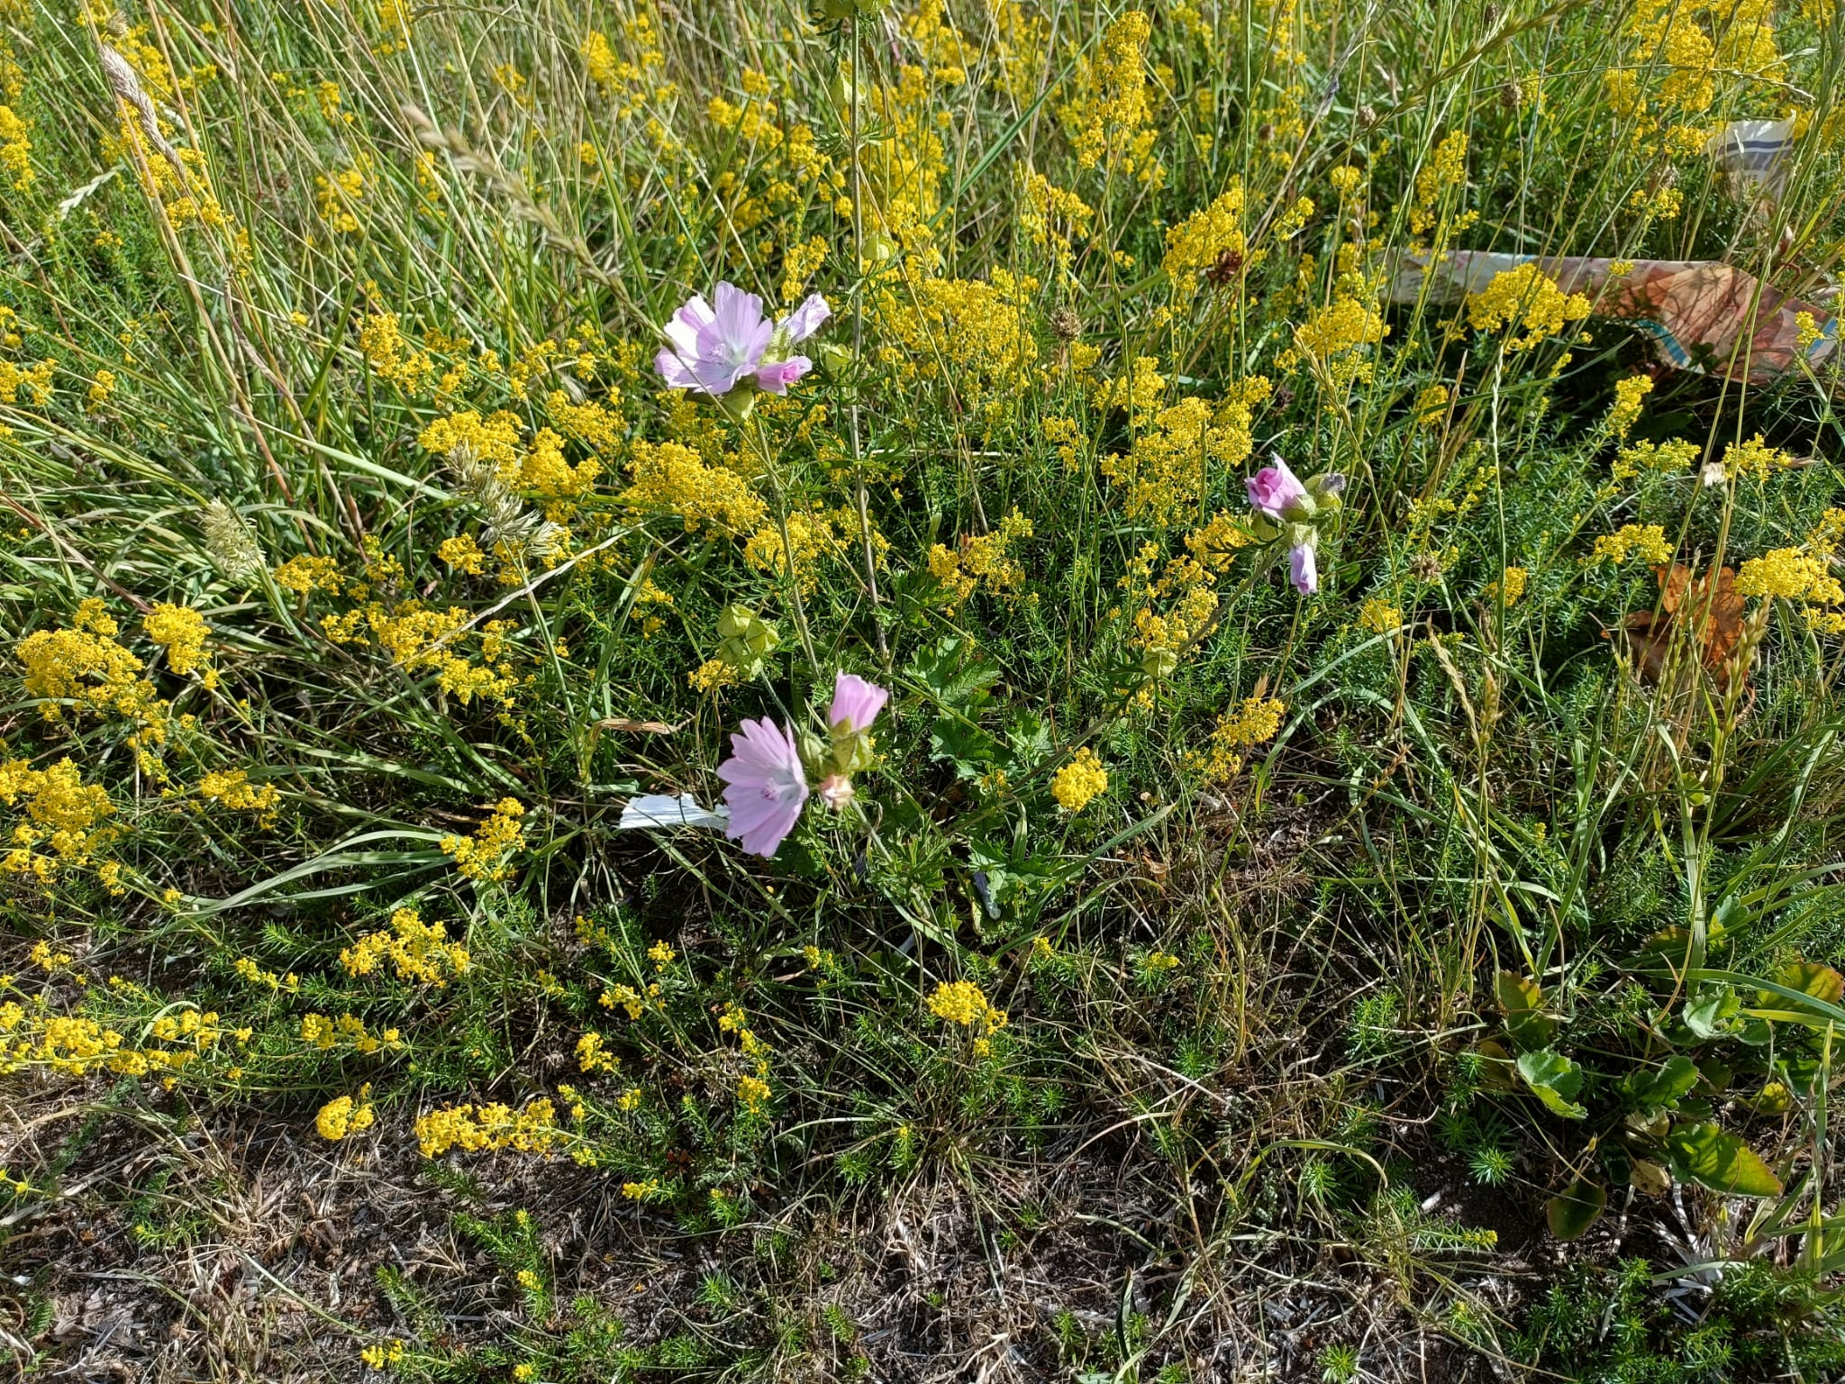
How to manage your verges for greater biodiversity, cont.
Consider road safety & visibility.
Raise awareness & increase understanding of the benefits for carbon & wildlife.
Let the community know the reasons for the change & what wildlife they can look forward to.
Notes:
What about planting wildflower plugs or resowing/returfing with wildflower meadow?
The best solution is to let the soil and seed bank regenerate naturally although this will take time. In small areas you can try to accelerate the process with wildflower plugs or wildflower turf but it may be short lived and expensive – perhaps only worth considering on a ’showcase’ area if you have the manpower/finances.
Involving and educating the community
There may always be some who see uncut verges as ‘messy’ rather than natural. Raising awareness and increasing understanding of the benefits for carbon and wildlife will encourage acceptance of any change. This may be achieved by putting up signs in the relevant area, writing articles in village newsletters and getting people involved e.g. making a compost heap for mowings or sowing seeds.

Slide 8
How to manage your verges for greater biodiversity, cont.
Remind people of the benefits of mowing with nature in mind:
  Reduced management costs long term,
  Nectar sugar resources for pollinators are maximised,
  Biodiversity is improved and increased,
  Essential wildlife corridors are created,
  Air and noise quality are improved, and
  Flooding risks are reduced.
Review & adapt as every piece of grass is different. It may take 10 years or more to see the full benefits.
Notes:
What about planting wildflower plugs or resowing/returfing with wildflower meadow?
The best solution is to let the soil and seed bank regenerate naturally although this will take time. In small areas you can try to accelerate the process with wildflower plugs or wildflower turf but it may be short lived and expensive – perhaps only worth considering on a ’showcase’ area if you have the manpower/finances.
Involving and educating the community
There may always be some who see uncut verges as ‘messy’ rather than natural. Raising awareness and increasing understanding of the benefits for carbon and wildlife will encourage acceptance of any change. This may be achieved by putting up signs in the relevant area, writing articles in village newsletters and getting people involved e.g. making a compost heap for mowings or sowing seeds.

Slide 9
References.
Plant life website: https://www.plantlife.org.uk/uk
‘Environmental Horticulture: Science and Management of Green Landscapes’ by Ross W F Cameron and James D Hitchmough 2016
The National History Museum at https://www.nhm.ac.uk/discover/why-road-verges-are-important-wildlife-habitats.html
Wildlife Trusts at https://www.wildlifetrusts.org/wildlife/managing-land-wildlife/managing-road-verges-wildlife
Hemmings K, Elton R, Grange I, No mow amenity grassland case study: Phenology of flower abundance and nectar resource, School of Agriculture, Food and Environment, Royal Agricultural University, 2022
Reduced Mowing in Wellesbourne 2023, Lucy Hartley
Warwickshire County Council www.warwickshire.gov.uk/grassverge
SWAN verges documents 1 and 2.

